Slide 1

Estimating the Circuit De-obfuscation Runtime based on Learning Methods
sixth Presentation

Slide 2
Work Report

Slide 3
Work Report
Conducted works on this week
Adding more scaler features by mean, variance, skewness, and kurtosis operators and using sequential forward feature selection (SFFS) to select the best of them on previous implementation
Notes:
Infertility : inability of couples to achieve pregnancy in one year.
It can have adverse effects on family’s aspects of life.
About 30-50% of infertility cases are due to male factor.
Semen analysis is the first step in diagnosis and treatment of male infertility.
Microscopic parts of semen analysis assess characteristics of sperm cells.

Slide 4
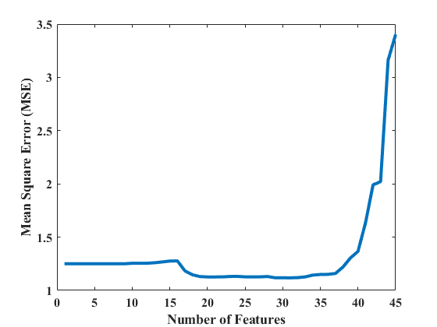
SFFS result
Among 50 scaler features, 31 features were selected by SFFS algorithm.
Notes:
Infertility : inability of couples to achieve pregnancy in one year.
It can have adverse effects on family’s aspects of life.
About 30-50% of infertility cases are due to male factor.
Semen analysis is the first step in diagnosis and treatment of male infertility.
Microscopic parts of semen analysis assess characteristics of sperm cells.

Slide 5
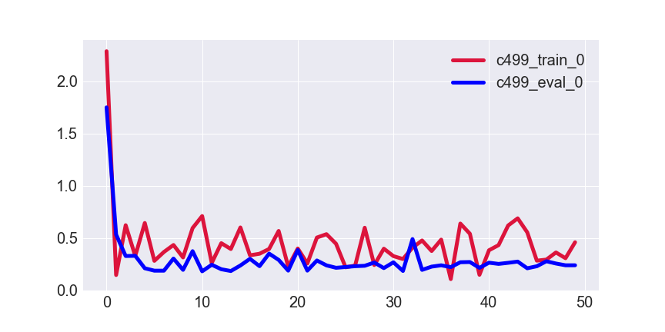
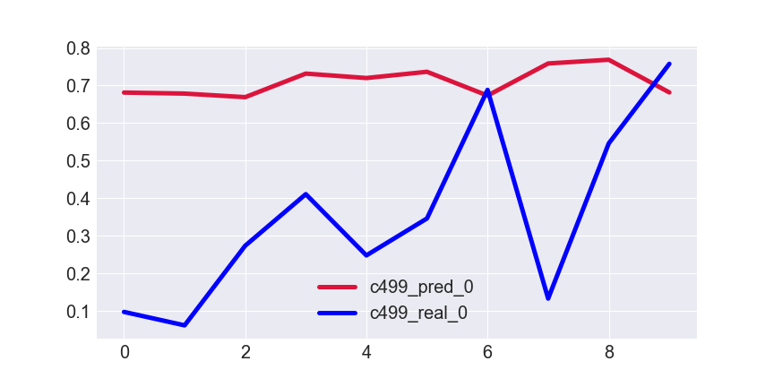
Results for K=1
De-obfuscation runtime
Normalized de-obfuscation runtime
Epoch
Testing data index
MSE for testing set → 0.1801
Notes:
Infertility : inability of couples to achieve pregnancy in one year.
It can have adverse effects on family’s aspects of life.
About 30-50% of infertility cases are due to male factor.
Semen analysis is the first step in diagnosis and treatment of male infertility.
Microscopic parts of semen analysis assess characteristics of sperm cells.

Slide 6
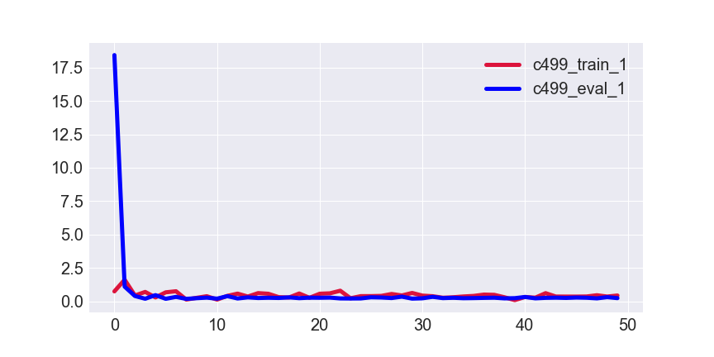
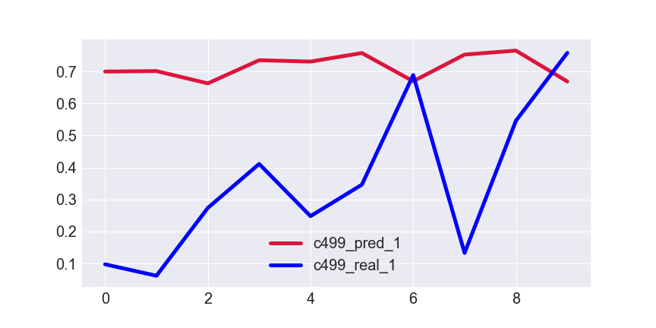
Results for K=2
De-obfuscation runtime
Normalized de-obfuscation runtime
Epoch
Testing data index
MSE for testing set → 0.1867
Notes:
Infertility : inability of couples to achieve pregnancy in one year.
It can have adverse effects on family’s aspects of life.
About 30-50% of infertility cases are due to male factor.
Semen analysis is the first step in diagnosis and treatment of male infertility.
Microscopic parts of semen analysis assess characteristics of sperm cells.

Slide 7
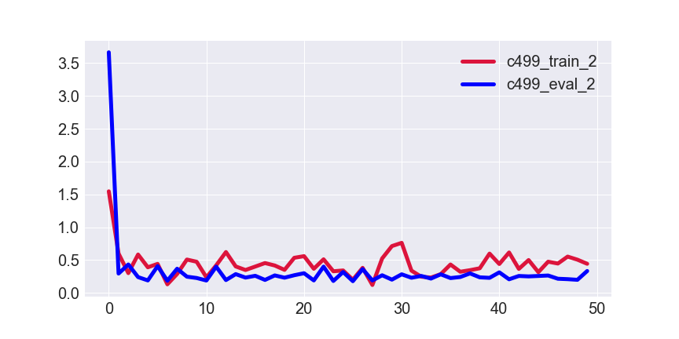
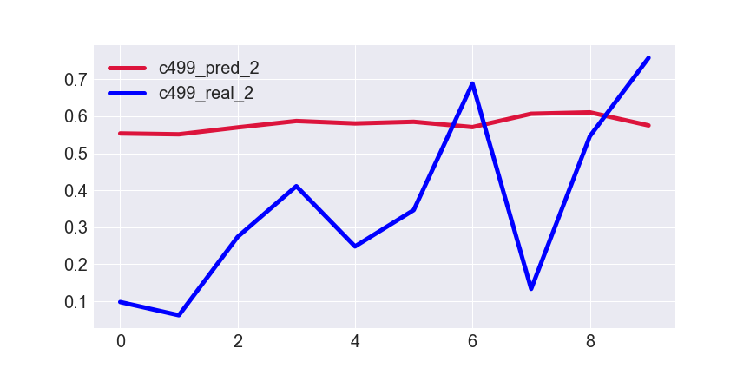
Results for K=3
De-obfuscation runtime
Normalized de-obfuscation runtime
Epoch
Testing data index
MSE for testing set →0.1008
Notes:
Infertility : inability of couples to achieve pregnancy in one year.
It can have adverse effects on family’s aspects of life.
About 30-50% of infertility cases are due to male factor.
Semen analysis is the first step in diagnosis and treatment of male infertility.
Microscopic parts of semen analysis assess characteristics of sperm cells.

Slide 8
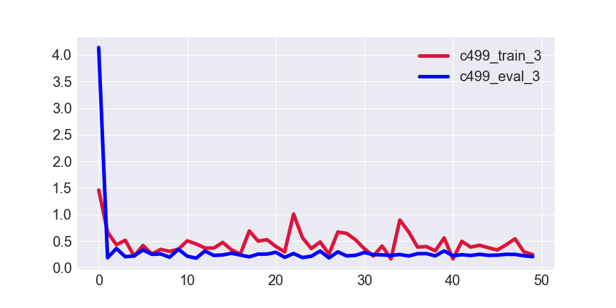
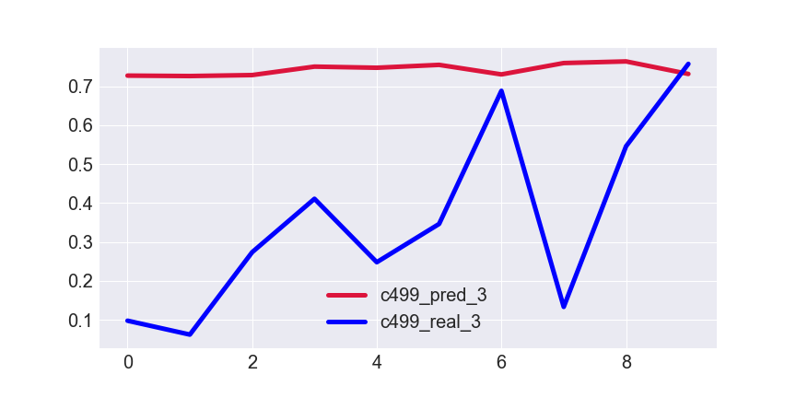
Results for K=4
De-obfuscation runtime
Normalized de-obfuscation runtime
Epoch
Testing data index
MSE for testing set → 0.2020
Notes:
Infertility : inability of couples to achieve pregnancy in one year.
It can have adverse effects on family’s aspects of life.
About 30-50% of infertility cases are due to male factor.
Semen analysis is the first step in diagnosis and treatment of male infertility.
Microscopic parts of semen analysis assess characteristics of sperm cells.

Slide 9
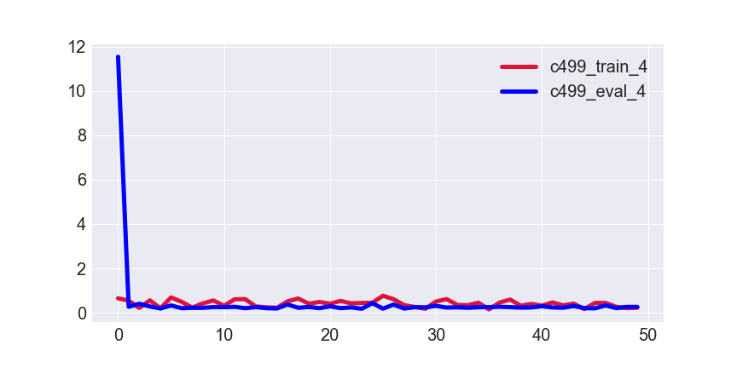
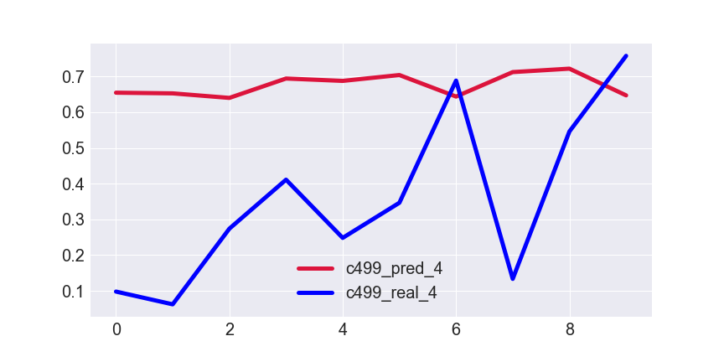
Results for K=5
De-obfuscation runtime
Normalized de-obfuscation runtime
Epoch
Testing data index
MSE for testing set → 0.1062
Notes:
Infertility : inability of couples to achieve pregnancy in one year.
It can have adverse effects on family’s aspects of life.
About 30-50% of infertility cases are due to male factor.
Semen analysis is the first step in diagnosis and treatment of male infertility.
Microscopic parts of semen analysis assess characteristics of sperm cells.

Slide 10
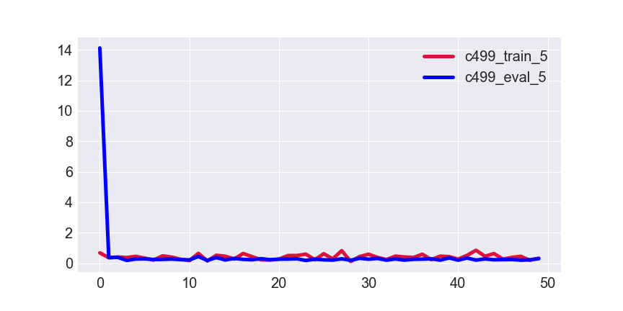
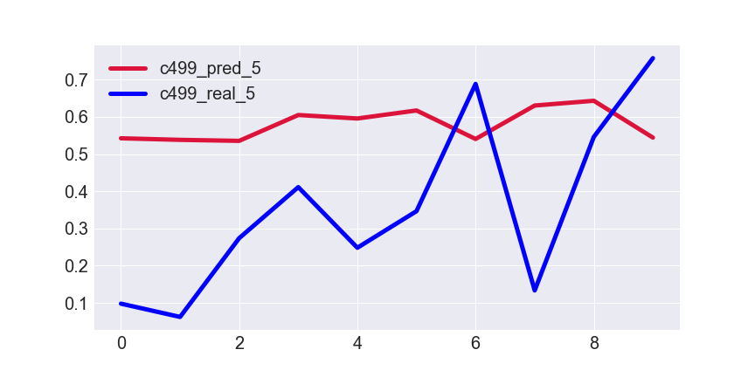
Results for K=6
De-obfuscation runtime
Normalized de-obfuscation runtime
Epoch
Testing data index
MSE for testing set → 0.1575
Notes:
Infertility : inability of couples to achieve pregnancy in one year.
It can have adverse effects on family’s aspects of life.
About 30-50% of infertility cases are due to male factor.
Semen analysis is the first step in diagnosis and treatment of male infertility.
Microscopic parts of semen analysis assess characteristics of sperm cells.

Slide 11
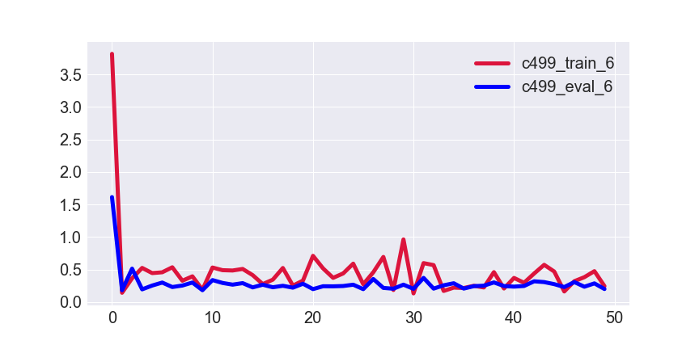
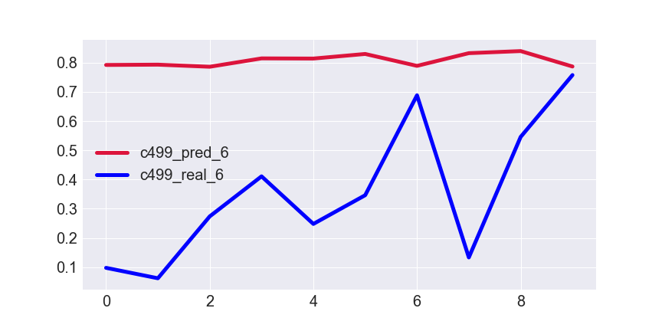
Results for K=7
De-obfuscation runtime
Normalized de-obfuscation runtime
Epoch
Testing data index
MSE for testing set →0.1048
Notes:
Infertility : inability of couples to achieve pregnancy in one year.
It can have adverse effects on family’s aspects of life.
About 30-50% of infertility cases are due to male factor.
Semen analysis is the first step in diagnosis and treatment of male infertility.
Microscopic parts of semen analysis assess characteristics of sperm cells.

Slide 12
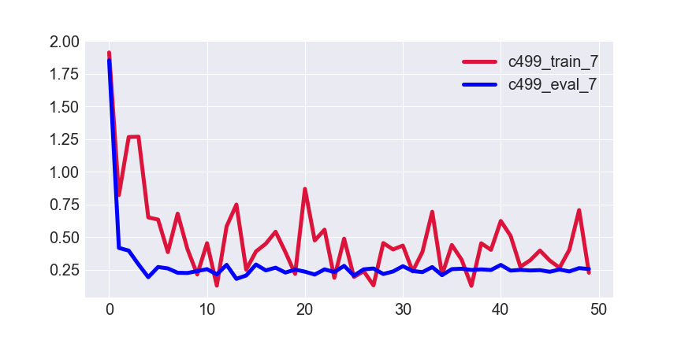

Results for K=8
De-obfuscation runtime
Normalized de-obfuscation runtime
Epoch
Testing data index
MSE for testing set → 0.2548
Notes:
Infertility : inability of couples to achieve pregnancy in one year.
It can have adverse effects on family’s aspects of life.
About 30-50% of infertility cases are due to male factor.
Semen analysis is the first step in diagnosis and treatment of male infertility.
Microscopic parts of semen analysis assess characteristics of sperm cells.

Slide 13
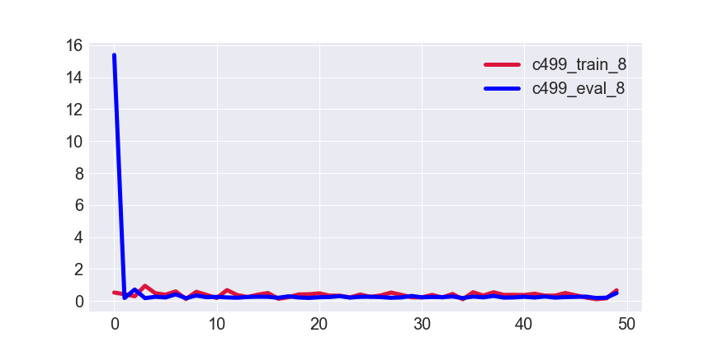
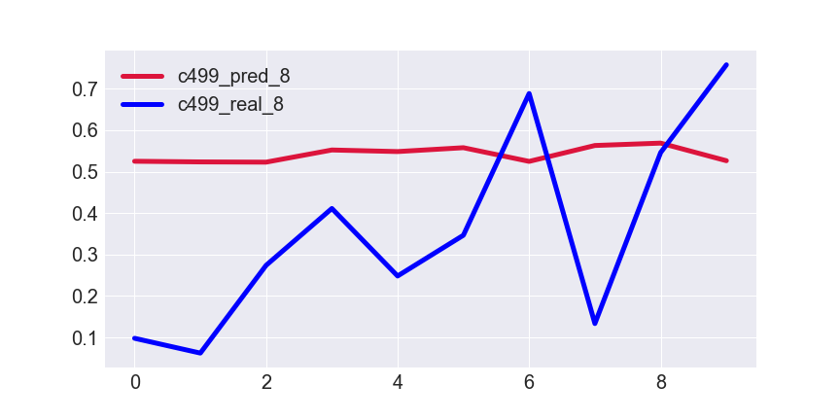
Results for K=9
De-obfuscation runtime
Normalized de-obfuscation runtime
Epoch
Testing data index
MSE for testing set → 0.1667
Notes:
Infertility : inability of couples to achieve pregnancy in one year.
It can have adverse effects on family’s aspects of life.
About 30-50% of infertility cases are due to male factor.
Semen analysis is the first step in diagnosis and treatment of male infertility.
Microscopic parts of semen analysis assess characteristics of sperm cells.

Slide 14
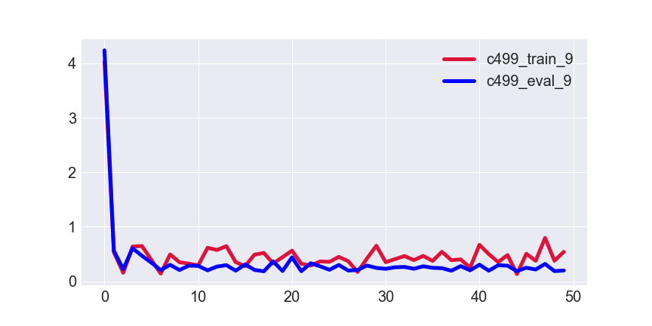
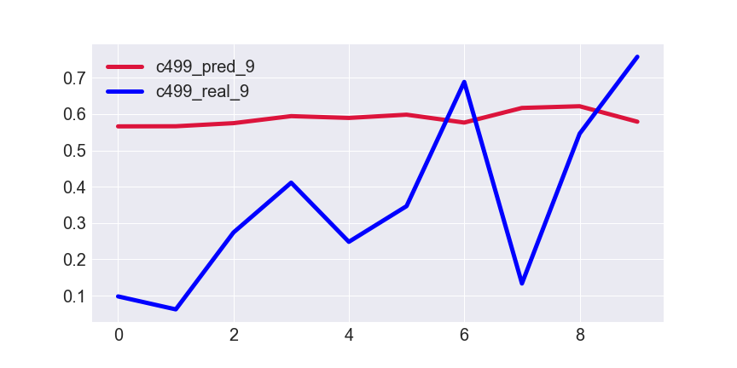
Results for K=10
De-obfuscation runtime
Normalized de-obfuscation runtime
Epoch
Testing data index
MSE for testing set → 0.0878
Notes:
Infertility : inability of couples to achieve pregnancy in one year.
It can have adverse effects on family’s aspects of life.
About 30-50% of infertility cases are due to male factor.
Semen analysis is the first step in diagnosis and treatment of male infertility.
Microscopic parts of semen analysis assess characteristics of sperm cells.

Slide 15
Table of MSE Results
K | MSE
1 | 0.1801
2 | 0.1867
3 | 0.1008
4 | 0.2020
5 | 0.1575
6 | 0.1048
7 | 0.2584
8 | 0.1667
9 | 0.0878
10 | 0.1062
Mean of MSE results → 0.1552
Std of MSE results → 0.1283
Notes:
Infertility : inability of couples to achieve pregnancy in one year.
It can have adverse effects on family’s aspects of life.
About 30-50% of infertility cases are due to male factor.
Semen analysis is the first step in diagnosis and treatment of male infertility.
Microscopic parts of semen analysis assess characteristics of sperm cells.

